Slide 1

Neuromarketing Insights: A Comprehensive Review of EEG Signal Classification and ML Models for Unveiling User Preferences
Research Methodology

Slide 2

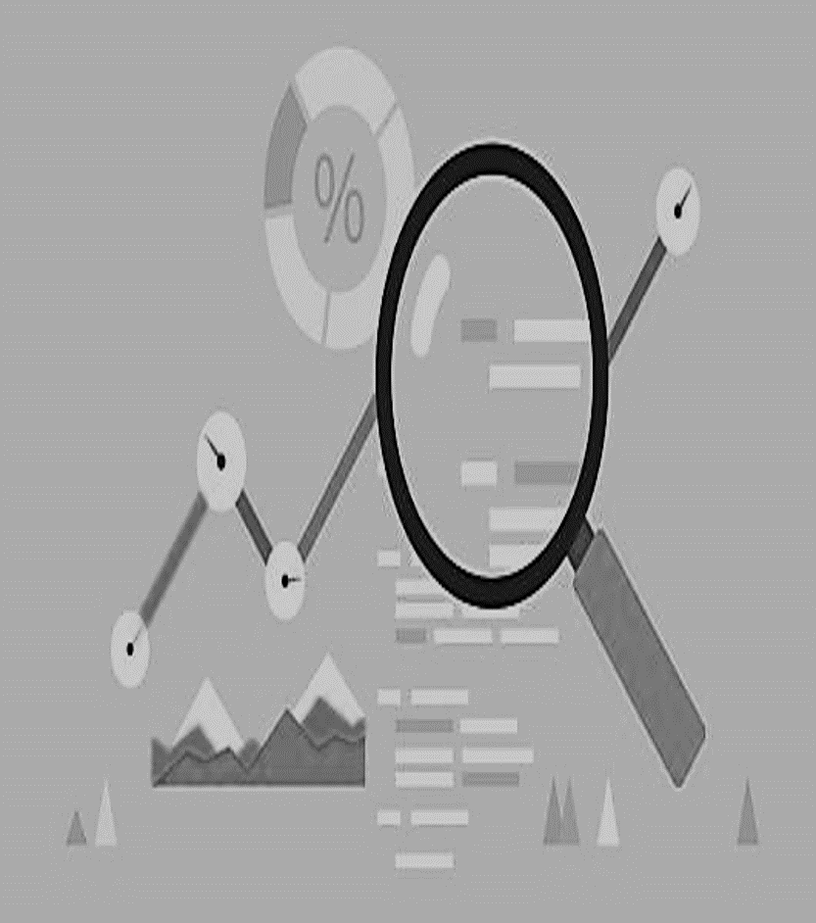





About today’s presentation
Methodology
Conclusion
Problem Statement
Literature Review
Introduction
Simulated Results

Slide 3
A Neuromarketing Journey
3. Design Stimuli:
Develop stimuli or scenarios that reflect real-world marketing situations. This could include advertisements, product displays, or brand imagery.
2. Select Neuroscientific Tools
Choose appropriate tools such as EEG, fMRI, or eye tracking
1. Define Objectives
Determine specific insights or information you are seeking to uncover through neuromarketing

Slide 4
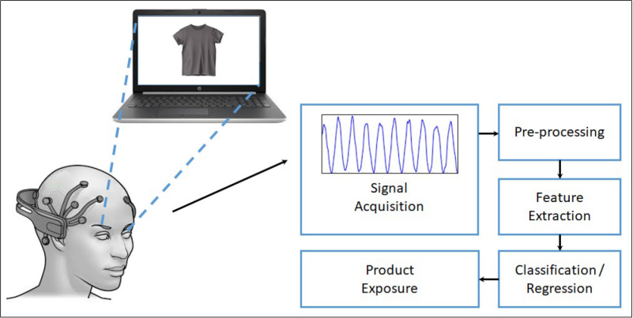
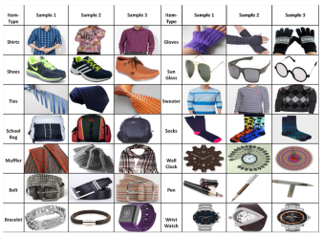
Process of Extracting EEG response For Yadava et al Datasets

Slide 5
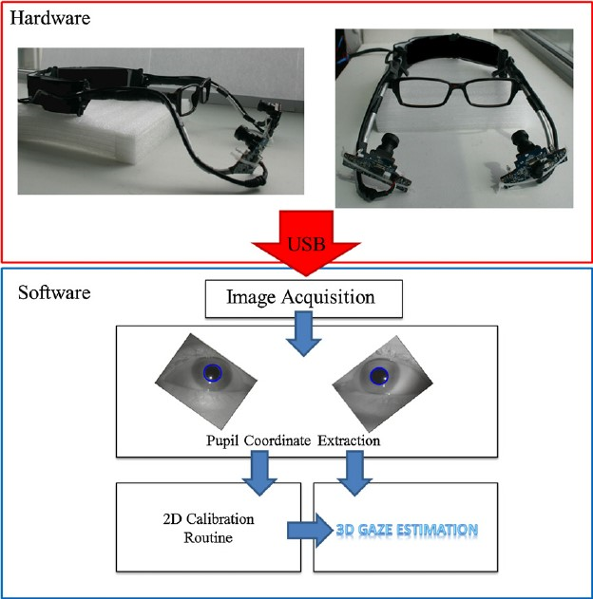
Process of Extracting EEG response For Neu MA Dataset

Slide 6
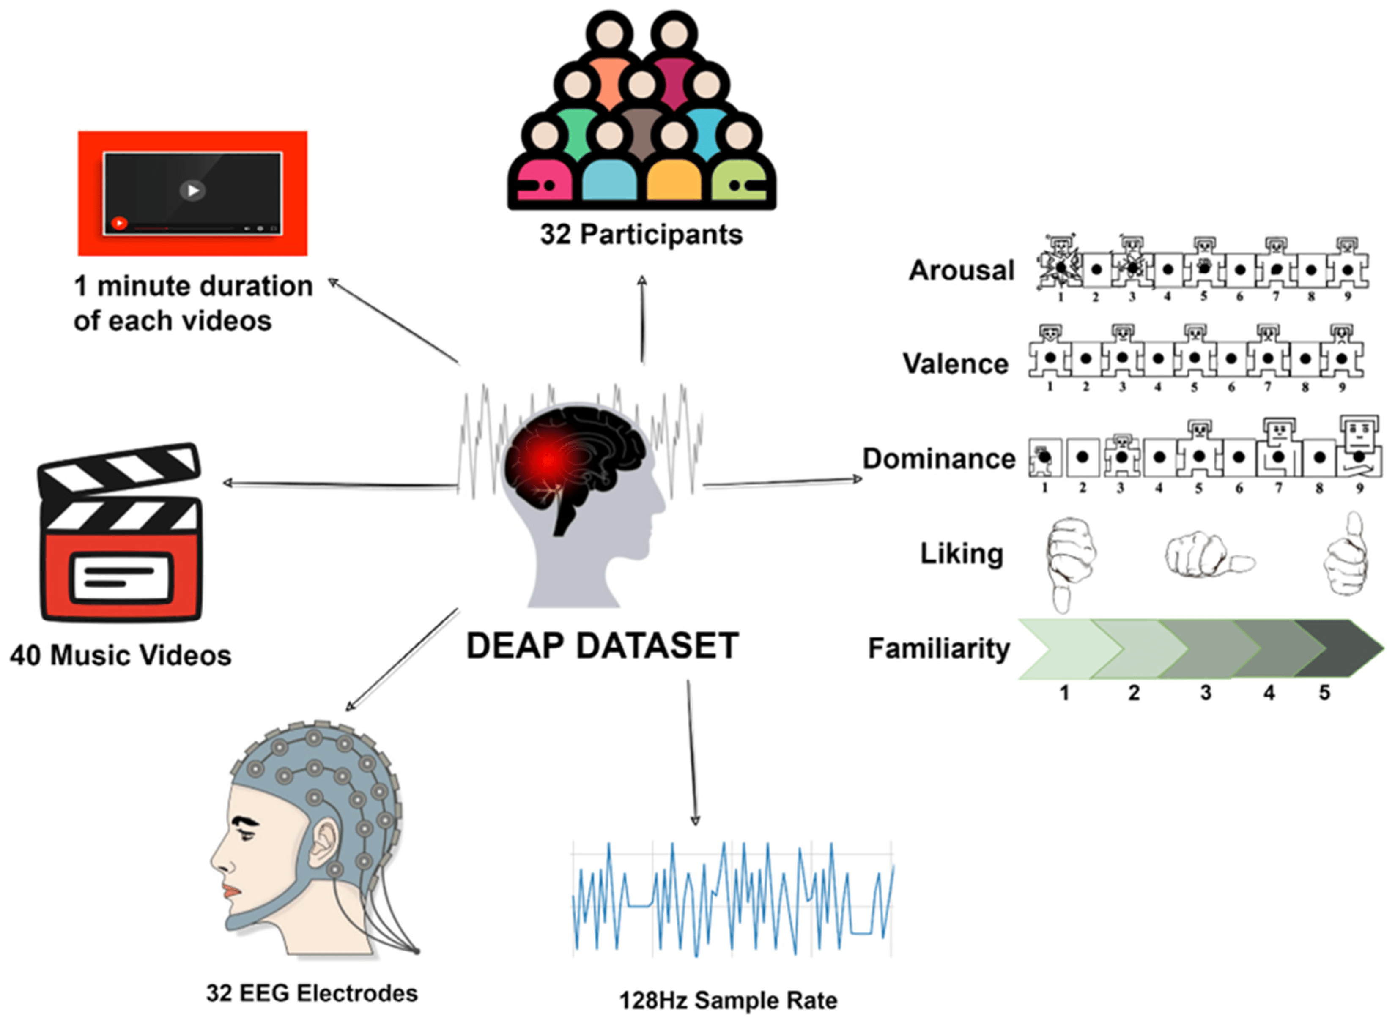
Extraction of EEG response For DEAP Dataset

Slide 7

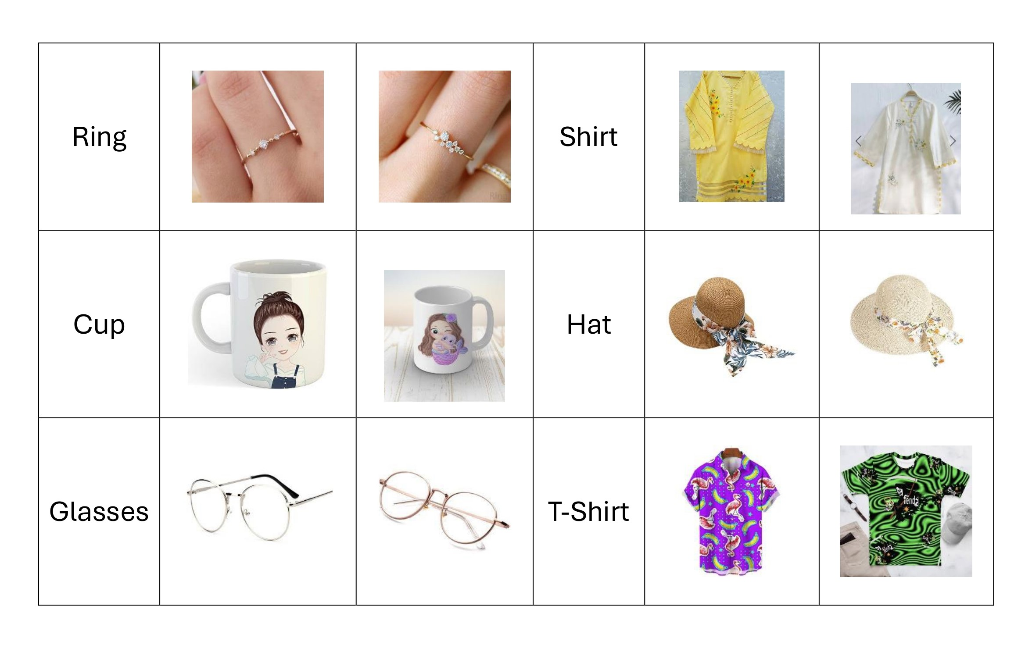
SINES Dataset

Slide 8





PROBLEM STATEMENT
Traditional marketing strategies inadequately capture consumer preferences, often relying on misleading feedback from conventional mediums.
The application of neuromarketing, leveraging EEG signals, presents a promising pathway.
The existing approaches require time-consuming preprocessing.
This review paper tackles the gap by surveying advanced machine learning models in EEG analysis, aiming to streamline the exploration of consumer preferences and contribute insights for businesses in the e-commerce sector.

Slide 9


LITERATURE REVIEW
survey of scholarly sources

Slide 10
Some of the Notable Studies from reviewed literature
Previous Work | Device/System | Dataset | Participants | Analysis Method | Accuracy/AUC Scores
Classification of consumer preferences based on changes analysis in the EEG signal of the brain | 14-channel Emotiv Epoc+ | 14 different product categories, | 25 participants (18-25 years | k-NN, RF, NN, GB | KNN(71.97%) RF(69.69%) NN: (76.02%) GB: (73.74%)
Analysis of EEG signals and its application to neuromarketing | Emotiv EPOC+ (14 channels | 42 images (14 categories) | 40 participants (25M, 15F) | Bayesian Cardinal HMM | Bayesian: 68.2% Cardinal: 65% HMM: 70.33%
Deep Learning for Neuromarketing Classification of User Preference using EEG Signals | 14-channel Emotiv Epoc+ | Dataset 1 (Product Choice) Dataset 2 (Movie Rating) | 25 participants (18-25 years) | DL Model (CNN), ML Model (Ensemble) | CNN:51.48% 63.54% Ensemble:50.71% :74.57%

Slide 11
Some of the Notable Studies from reviewed literature
Previous Work | Device/ System | Dataset | Participants | Analysis Method | Accuracy
EEG-Based Preference Classification for Neuromarketing Application | 14-channel EMOTIV EPOC+ | Approximately 1400 feedback responses as likes/dislikes | 49 subjects (24 males and 25 females) | PNN, DNN, KNN, SVM | PNN: 96.62% KNN: 84.82% SVM: 89.36% DNN: 79.76%
Deep Learning for EEG-Based Preference Classification in Neuromarketing | A BCI System | DEAP Database | 32 participants (19-37 years) | SVM, Log. Reg., HMM, KNN+TF, DNN | SVM: 75.44% Log. Reg.: 67.32% HMM: 70.33% KNN + TF: 83.34% DNN: 63.99%
Neuromarketing Solutions based on EEG Signal Analysis using Machine Learning | Muse 2 headset | 10 different product categories and three different image | 15 participants | ANN, SVM, Decision tree, and K-Nearest Neighbors | ANN: 50.4% DT: 57.3% KNN: 60.89% Log. Reg: 51.34%

Slide 12



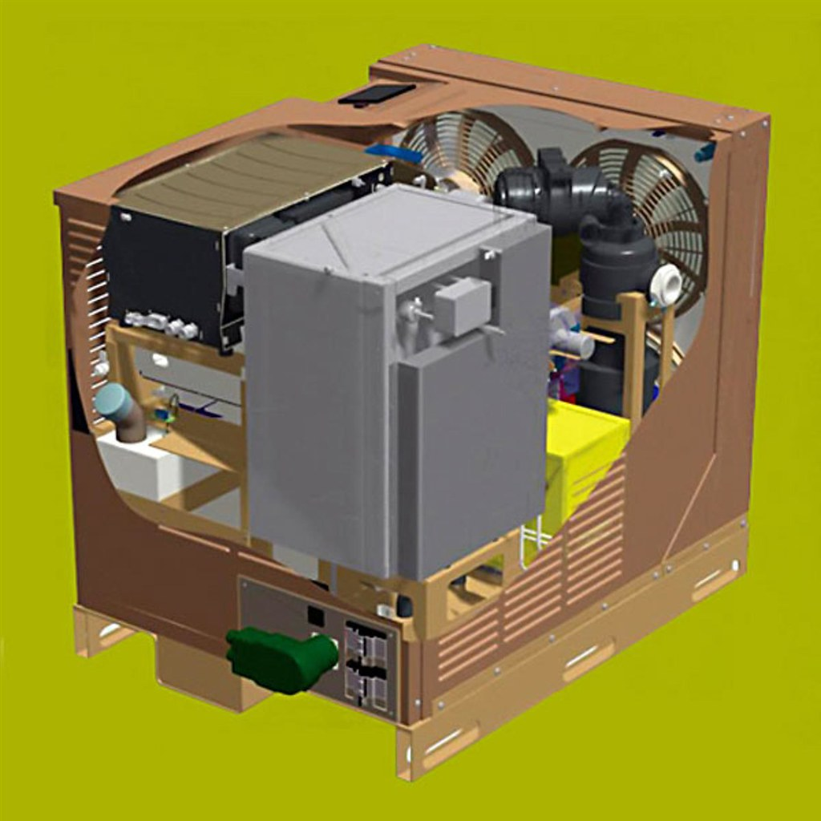
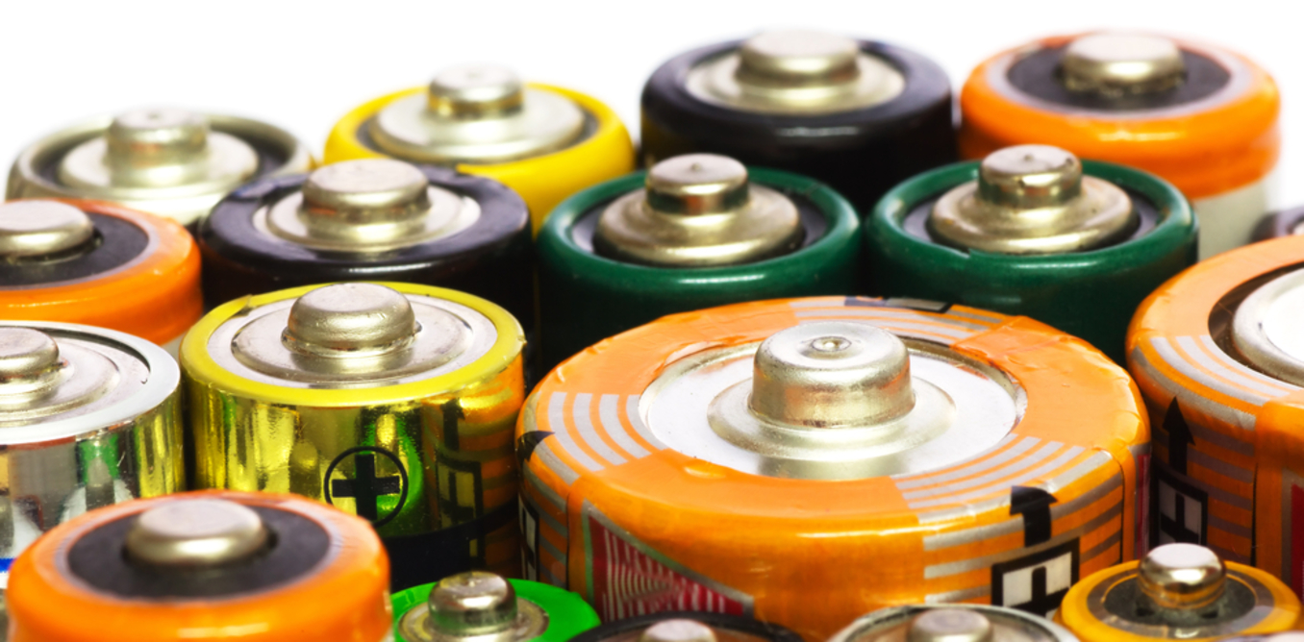
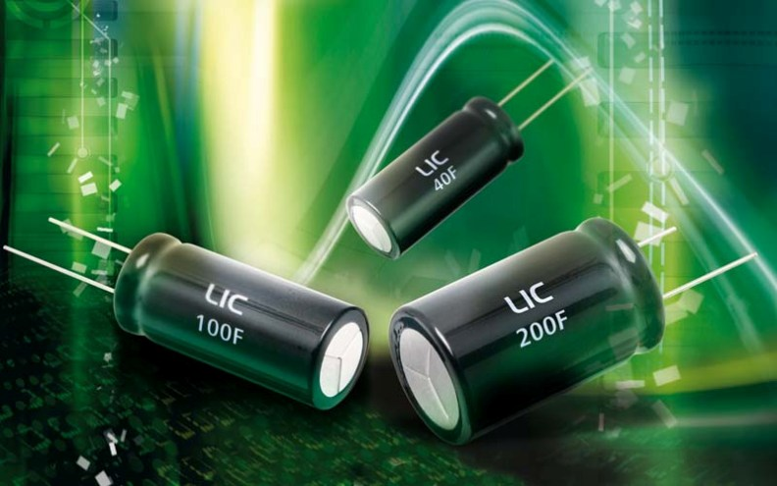
METHODOLOGY

Slide 13

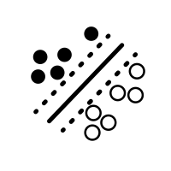

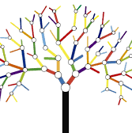
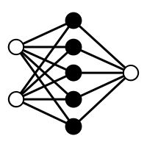

Machine learning Models
Implementation of KNN classifier
Implementation of SVM Classifier
Extreme Gradient Boosting
Random Forest
Artificial Neural Networks

Slide 14
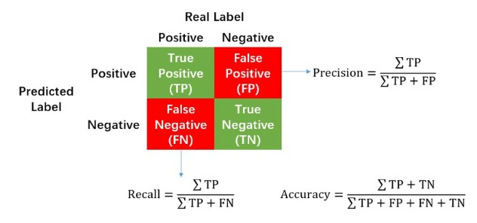
Precision, Recall & Accuracy

Slide 15
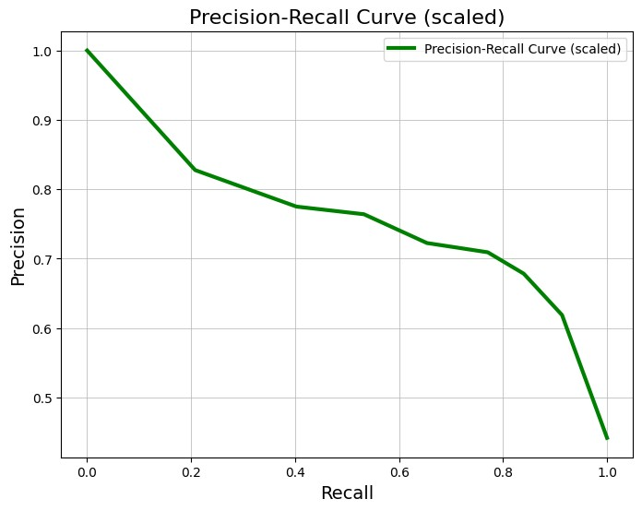
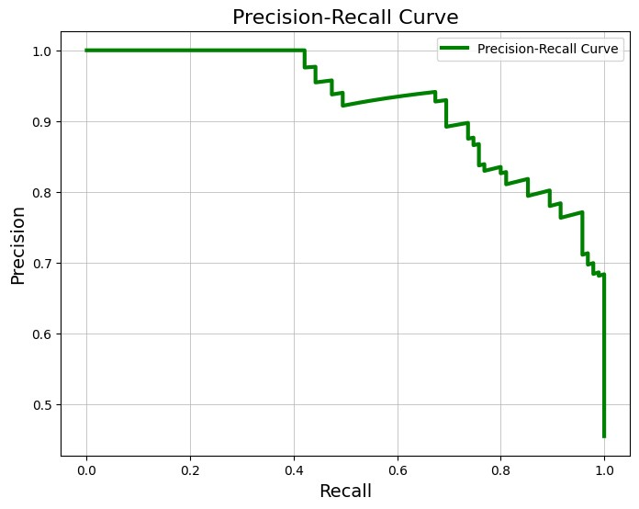
Precision-Recall Curve
For KNN Classifier
For SVM classifier

Slide 16
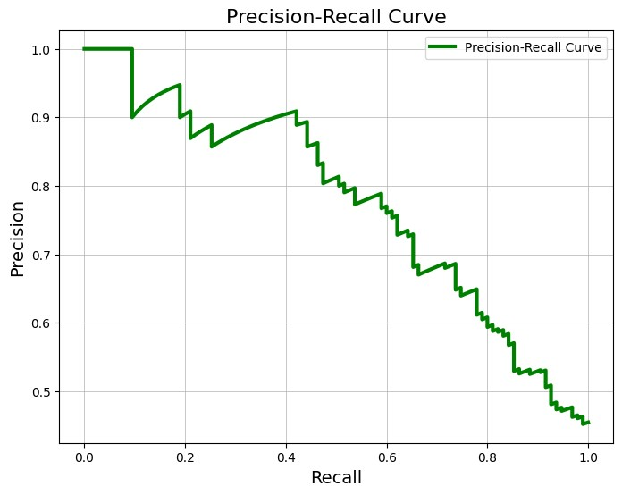
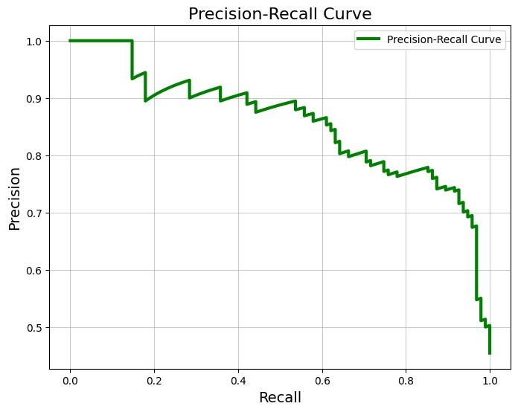
Precision Recall Curve
For Gradient Boost Classifier
For Artificial Neural Network

Slide 17
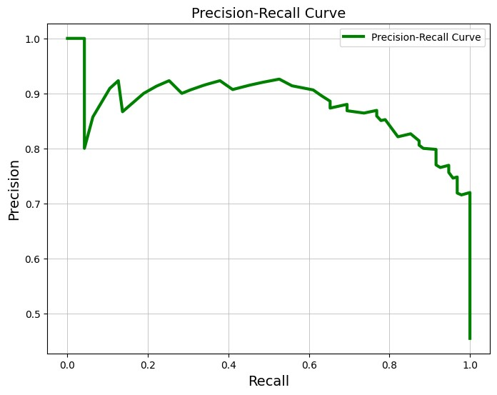
Precision-Recall Curve
For Random Forest

Slide 18

RESULTS

Slide 19
RESULTS
Analysis Algorithm | Precision | Recall | Accuracy
KNN Algorithm | Class 0 0.69 Class 1 0.67 | Class 0 0.78 Class 1 0.56 | 68%
Scaled KNN Classifier | Class 0 0.75 Class 1 0.72 | Class 0 0.80 Class 1 0.65 | 74%
SVM Classifier | Class 0 0.72 Class 1 0.73 | Class 0 0.81 Class 1 0.63 | 73%
Scaled SVM Classifier | Class 0 0.88 Class 1 0.80 | Class 0 0.82 Class 1 0.86 | 84%
Random Forest | Class 0 0.89 Class 1 0.80 | Class 0 0.82 Class 1 0.88 | 85%
Gradient Boost | Class 0 0.87 Class 1 0.79 | Class 0 0.82 Class 1 0.85 | 83%
ANN Classifier | Class 0 0.87 Class 1 0.79 | Class 0 0.82 Class 1 0.85 | 82%
An autonomous DC microgrid structure was illustrated
to show the suitability of such a multi-source microgrid system
for different areas.
Two level hierarchical control was developed, and its efficiency for the voltage bus regulation and optimal energy usage was proved.
Fuzzy logic and the artificial neural network-based MPPT algorithms effectively helped to extract maximum power.
Power balance ensured and the SoC of battery and SC were kept within a reasonable range. Optimal hydrogen consumption of FC was also ensured.
STSMC and ATSMC appeared to be most effective for foreign and local region, respectively. Experimental results were found to be in close approximation with simulated results.

Slide 20
SINES DATA Result
The accuracy on all models is about 50% which is very low. The main reasons for that are.
The main data set is recorded by 14 electrodes and the new one is off 1 electrode.
There are a lot of data preprocessing techniques have been implemented on the Yadava dataset, but we haven’t applied any data preprocessing technique.

Slide 21
CONCLUSION
Each model presented distinct advantages and trade-offs. KNN showed promise with its simplicity, SVM excelled in discerning complex decision boundaries, Random Forest and XGBoost demonstrated robust ensemble learning capabilities, and ANNs exhibited proficiency in capturing complex non-linear relationships. The choice of the most suitable model depends on the specific goals and characteristics of the EEG dataset

Slide 22
THANK YOU!

